Slide 1
Digital Asset Content Management
An application for content distribution

Slide 2
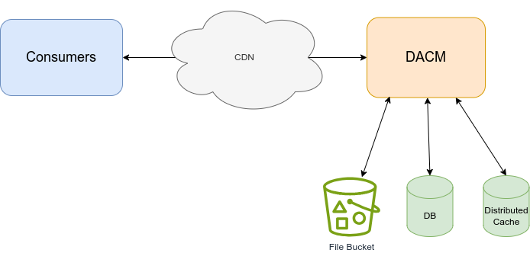
Container Diagram

Slide 3
Design Decisions
Functional folder structure
Local memory cache
Enums for “fileFormat” and “assetStatus”
Changed “fileSize” to integer
Fixed missing reference in “BriefingMetadata.json”

Slide 4
Challenges
Docker compose
Getting back into C#

Slide 5
Improvements
Two-layer caching (local memory and distributed cache)
Authentication / Authorization
AWS S3
CDN (Akamai, Fastly, Cloudfront etc.)
CI/CD (AWS CloudFormation/Terraform)
Split the solution into multiple projects
Refactor folder structure from functional to domain based approach
Better swagger documentation
Unit Test
Error handling and logging
Adding a queue service for event driven parts of the solution
Business models and api models

Slide 6
Collaboration
Get stakeholder input on functionality
Define user stories
Divide solution into multiple parts that can be worked on in parallel (eg. api, admin portal, business logic)

